Slide 1
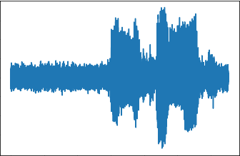
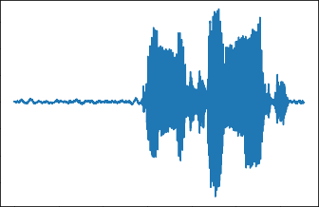
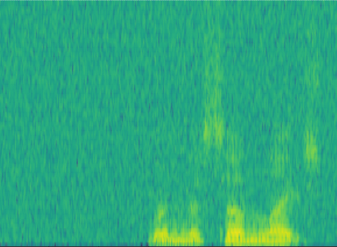
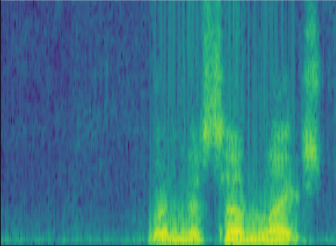




第3节中提到的相关变量应标记在图2中，以提高文章的可读性
在图2中，没有CFIM。是否应该是复杂范围融合单元（CSFU）？
Sub-Sampler
$$S_{noise_{2}}$$
$$S_{noise_{2}}$$
Loss→Update Net
$$S_{noise_{1}}$$
$$S_{denoised_{1}}$$
$$S_{noise}$$
STFT
Net
ISTFT
Masking
Donwsampling
SDFU
CMFFU
Decoder
Input Noise
Downsampling
Encoder
Decoder
Upsampling
Output Denoised
CConv2d
SDFU
ReLU
CBN
CMFFU
CBN
RuLU
Encoder
Decoder
CDeconv2d
Encoder
SDFU
CMFFU
Decoder
CMA
Encoder
Decoder
Upsampling
Donwsampling
SDFU
CMFFU
CMA
Upsampling
Encoder
CSFU
Upsampling
Output Denoised Spectrogram
Input Noise Spectrogram
CMA
Complex Multi-scale attention Module
SDFU
Spectrum dynamic focusing Unit
Downsampling
Complex Scope Fusion Unit
Complex Multi-Scale Feature Fusion Unit
CSFU
CMFFU

